Slide 1

CLINICAL AND PATHOLOGIC CHARACTERISTICS OF HEAD AND NECK SQUAMOUS CELL CANCER IN YOUNG ADULTS OF AN ONCOLOGY CENTER IN BRAZIL
Wilker Dias Martins
M.D., PGY3 Surgical Pathology - HC-FMUSP
May 30th, 2024

Slide 2
Introduction

Slide 3
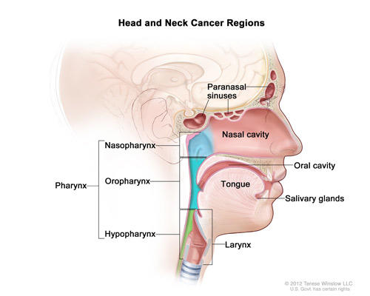
Introduction
Head and neck squamous cell carcinoma (HNSCC) it's a public health problem ¹
800,000 new cases yearly worldwide
450.000 deaths
Brazil (INCA):
2023 to 2025 -> Oral cavity: 8th place - 15,100 new cases ²
Estimated risk of 6.99 per 100 thousand inhabitants
Credit: © Terese Winslow

Slide 4
Introduction
Increasing incidence of head and neck cancers in young patients ^{3, 4}
Variable: 0,2 - 5,5%
External risk factors: tobacco and alcohol consumption / HPV infection
Genetic predisposition
Prevention
Behavior
Treatment
HNSCC in young patients
Notes:
3,6%

Slide 5
Objectives

Slide 6
Objectives
Evaluate the epidemiological and anatomopathological characteristics and outcomes of young patients (under 40 years old) diagnosed with primary head and neck squamous cell carcinoma (HNSCC) treated at an oncology reference hospital in the state of São Paulo

Slide 7
Methods

Slide 8
Methods
Partial retrospective review
Histologically confirmed cases of HNSCC
  Patients up to 40 years of age
    January 1, 2007 to February 1, 2024 (18 years)
      Clinical and anatomopathological data
Age
Type of material
Tumor site
p16 status
Sex
Histological subtype
Histological grade
Survival

Slide 9
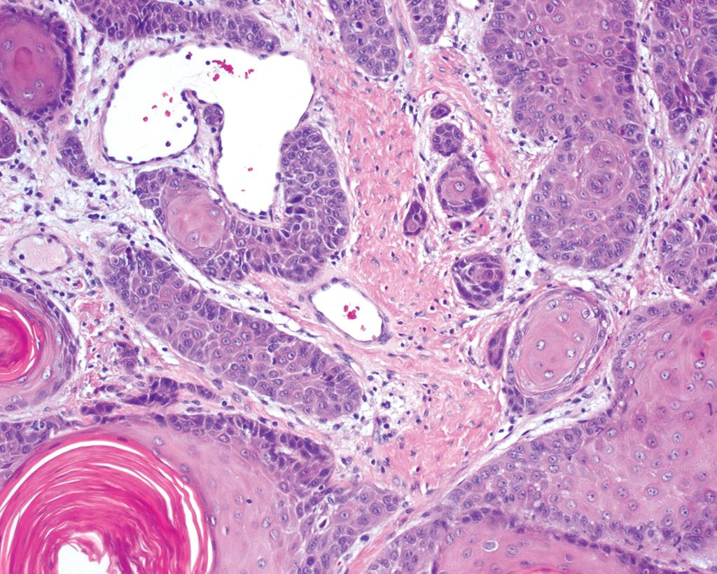
Methods
In operated cases:
  Size
  Tumor thickness
  Depth of invasion (DOI)
  Vascular invasion
  Perineural spread
  Primary tumor size (pT)
  Nodal status
  Surgical margins
Figure. Squamous cell carcinoma. Adapted from WHO Classification of Tumours Editorial Board. Head and neck tumours [Internet]. Lyon (France): International Agency for Research on Cancer; 2023 [cited 2024 May 30th]. (WHO classification of tumours series, 5th ed.; vol. 9). Available from: https://tumourclassification.iarc.who.int/chapters/52.

Slide 10
Results

Slide 11
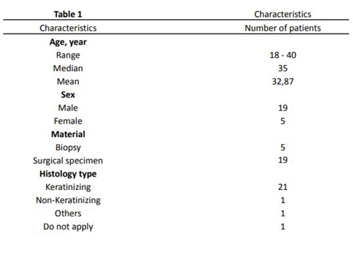
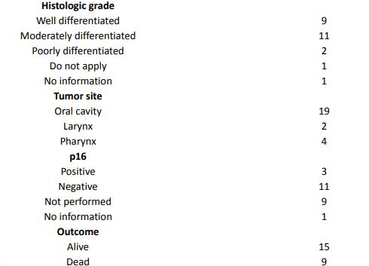
Results - Clinicopathological characteristics of HNSCC patients (n=24)

Slide 12
Results - Clinicopathological characteristics of HNSCC patients (n=24)
The InterCHANGE study
Overall survival
South America
1463 patients
OS: 54,1%
62,5%

Slide 13
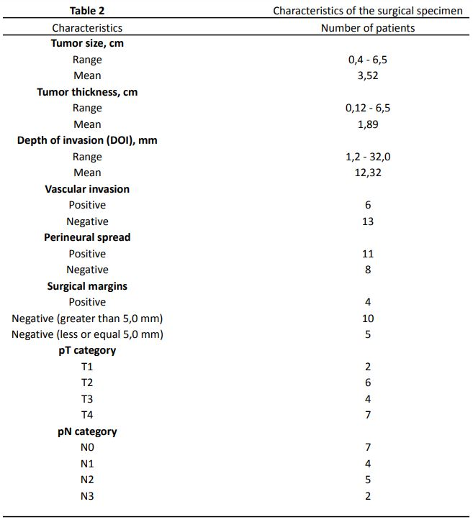
Results – Histopathological characteristics of HNSCC patients (n=19)
Notes:
Margem, DOi, invasão perineural, estadiamento

Slide 14
Conclusion

Slide 15
Conclusion
Men (79,16%)
Keratinizing histological subtype (87,5%)
Moderately differentiated (45,83%)
Negative for p16
Oral cavity (79,16%)
Advanced disease (T3-T4): 57,89%
Nodal metastasis (N+): 61,11%
Margins >5mm: 52,63%
Perineural invasion: 57,89%
Angiolymphatic invasion: 31,57%
Positive lymph nodes: 61,11%
In this series

Slide 16
Conclusion
Amorim MM et. al, 2019. Survival of young adults with oral squamous cell carcinoma in a brazilian population
In this series
Men (79,16%)
Keratinizing histological subtype (87,5%)
Moderately differentiated (45,83%)
Negative for p16
Oral cavity (79,16%)
Advanced disease (T3-T4): 57,89%
Nodal metastasis (N+): 61,11%
Brazil
2010-2016
35 patients (<45 years old)
Oral cavity
Results:
Male (88,6%)
Advanced stage (93,8%)
+ Nodal metastasis (71,4%)
OS: 77,14%

Slide 17
Conclusion
Révész M. et. al. 2023. The characteristics of head and neck squamous cell cancer in young adults: A retrospective single-center study.
In this series
Men (79,16%)
Keratinizing histological subtype (87,5%)
Moderately differentiated (45,83%)
Negative for p16
Oral cavity (79,16%)
Advanced disease (T3-T4): 57,89%
Nodal metastasis (N+): 61,11%
Hungary
2000-2018
85 patients (<40 years old)
Results:
Oral cavity (56,4%)
Male (78,9%)
Early stages (67%)
+ Nodal metastasis (63,5%)
OS: 44,2%

Slide 18
Conclusion
Tomo S. et. al, 2020. Head and neck squamous cell carcinoma in young patients: a 26-year clinicopathologic retrospective study in a Brazilian specialized center.
In this series
Men (79,16%)
Keratinizing histological subtype (87,5%)
Moderately differentiated (45,83%)
Negative for p16
Oral cavity (79,16%)
Advanced disease (T3-T4): 57,89%
Nodal metastasis (N+): 61,11%
Brazil
1991-2016
89 patients (<45 years old)
Results:
Male (87,6%)
Oral cavity (38,6%)
Advanced stage (60,9%)
+ Nodal metastasis (54,0%)

Slide 19
Conclusion
Myers JN, et. al. 2000. Squamous cell carcinoma of the tongue in young adults: increasing incidence and factors that predict treatment outcomes.
In this series
USA
1973-1995
64 patients (<40 years old)
Results:
Increase in incidence (10% -> 15% and 25%)
Pathologic criteria:
Margins <=5 mm
Perineural invasion
Lymphatic invasion
Positive lymph nodes
Margins >5mm: 52,63%
Perineural invasion: 57,89%
Angiolymphatic invasion: 31,57%
Positive lymph nodes: 61,11%

Slide 20
Conclusion
Positive points
Negative points
Follow up in a single institution
Tertiary reference center
Reliably anatomoclinical characteristics
Does it reflect reality?
Notes:
Ver trabalhos com os fatores prognósticos em pacientes jovens - se não tiver, é ponto positivo.

Slide 21
Conclusion - What now?
N = 101 patients
  Sex: Male = 76,23%
  Age: Mean = 34,63
  Histological subtype: Keratinizing (50,49%)
  Histological grade: Moderately differentiated (45,54%)
  p16 status: Negative = 23 / Positive = 7
  Tumor site: Oral cavity (66,33%)
  Overall survival: 54,08%
The InterCHANGE study
Notes:
Comentar sobre a intenção de publicar com a casuística completa.

Slide 22
Conclusion - What now?
Surgical specimen = 51 patients
  Tumor size: Mean = 3,68 (Range = 0,6 - 12,5)
  Tumor thickness: Mean = 1,73 (Range = 0,11 - 6,5)
  DOI: Mean = 9,18 (Range = 0,12 - 32)
  Vascular invasion: Positive in 38,29%
  Perineural spread: Positive in 41,3%
  Surgical margins (negative): 83,33%
  pT category: T3 and T4 = 53,19%
  pN category: N+ in 46,93%
Notes:
Ver trabalhos com os fatores prognósticos em pacientes jovens - se não tiver, é ponto positivo.

Slide 23
References

Slide 24
References
1) Global cancer statistics 2020: GLOBOCAN estimates of incidence and mortality worldwide for 36 cancers in 185 countries. Sung H, Ferlay J, Siegel RL, Laversanne M, Soerjomataram I, Jemal A, Bray F. CA Cancer J Clin. 2021;71:209–249.
2) Ministério da Saúde Instituto Nacional de Câncer José Alencar Gomes da Silva Ministério da Saúde Instituto Nacional de Câncer [Internet]. Available from: https://www.inca.gov.br/sites/ufu.sti.inca.local/files//media/document//estimativa-2023.pdf
3) Tomo S, Neto SC, Collado FU, Sundefeld ML, Bernabé DG, Biasoli ÉR, Miyahara GI. Head and neck squamous cell carcinoma in young patients: a 26-year clinicopathologic retrospective study in a Brazilian specialized center. Med Oral Patol Oral Cir Bucal. 2020 May 1;25(3):e416-e424. doi: 10.4317/medoral.23461. PMID: 32134900; PMCID: PMC7211379.
4) Toner M, O'Regan EM. Head and neck squamous cell carcinoma in the young: a spectrum or a distinct group? Part 1. Head Neck Pathol. 2009 Sep;3(3):246-8. doi: 10.1007/s12105-009-0135-0. Epub 2009 Aug 19. PMID: 20596979; PMCID: PMC2811623.
4) Hussein AA, Helder MN, de Visscher JG, Leemans CR, Braakhuis BJ, de Vet HCW, Forouzanfar T. Global incidence of oral and oropharynx cancer in patients younger than 45 years versus older patients: A systematic review. Eur J Cancer. 2017 Sep;82:115-127. doi: 10.1016/j.ejca.2017.05.026. Epub 2017 Jun 24. PMID: 28654785.

Slide 25
References
5) Révész M, Oberna F, Slezák A, Ferenczi Ö, Kenessey I, Takácsi-Nagy Z. The characteristics of head and neck squamous cell cancer in young adults: A retrospective single-center study. Pathol Oncol Res. 2023 Apr 24;29:1611123. doi: 10.3389/pore.2023.1611123. PMID: 37168050; PMCID: PMC10164923.
6) Renata Abrahão et al., Predictors of Survival After Head and Neck Squamous Cell Carcinoma in South America: The InterCHANGE Study. JCO Glob Oncol 6, 486-499(2020). DOI:10.1200/GO.20.00014
7) Amorim MM, Leite MCS, Alves LDB, Silva CALD, Santos JND, Freitas VS. Sobrevida de adultos jovens com carcinoma de células escamosas oral em uma população do Brasil [Survival of young adults with oral squamous cell carcinoma in a brazilian population]. Rev Salud Publica (Bogota). 2019 Sep 1;21(5):534-540. Portuguese. doi: 10.15446/rsap.V21n5.76193. PMID: 36753205.
8) Myers JN, Elkins T, Roberts D, Byers RM. Squamous cell carcinoma of the tongue in young adults: increasing incidence and factors that predict treatment outcomes. Otolaryngol Head Neck Surg. 2000 Jan;122(1):44-51. doi: 10.1016/S0194-5998(00)70142-2. PMID: 10629481.

Slide 26
Thanks!
E-mail: wdm1998@gmail.com

